Slide 1
This slide is hidden.
Insert the starting slides after this slide

Slide 2
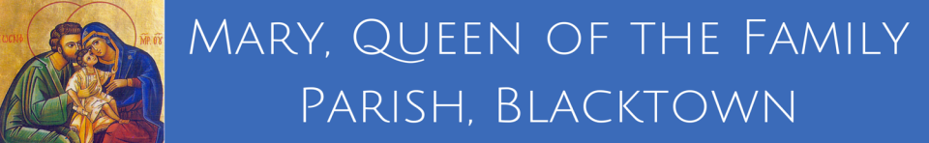
Mary, Queen of the Family Parish
is a welcoming, diverse, multicultural, Catholic community.
We seek to live, teach and share the joy of the Gospel; to grow as disciples of Jesus through prayer, witness and action and to respond to the needs of the family in the Blacktown community and beyond.
Notes:
Saturday 5.30PM First Sunday of Advent
8th Sunday in Ordinary Time - Year A

Slide 3
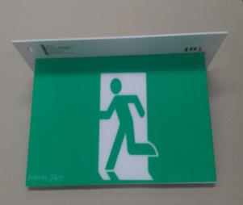
SAFETY MESSAGE
Please take a moment to
identify your closest exit.
There will be an announcement if we need to evacuate the building.
Evacuate the building via the nearest Exit & proceed directly to the footpath along Orwell Street.
DO NOT move any vehicles or remain in the car park.
Notes:
St Michael’s Safety Message
8th Sunday in Ordinary Time - Year A

Slide 4


Welcome to our Parish
Palm Sunday
of the Passion
of the Lord
- Year A -
You have entered a SACRED SPACE ... A SACRED TIME
Please ensure all mobile phones are switched off.
Please be respectfully quiet at this time.
Notes:
Saturday 5.30PM First Sunday of Advent
8th Sunday in Ordinary Time - Year A

Slide 5

PLEASE MOVE OUTSIDE
TO GATHER
FOR OUR
PALM SUNDAY PROCESSION
Notes:
8th Sunday in Ordinary Time - Year A

Slide 6
This slide is hidden.
Insert the Entrance Hymn after this slide

Slide 7
Victory Chant
Hail Jesus, you're my king
Your life frees me to sing
I will praise you all my days
You're perfect in all your ways
Licence No. CCLI 312895

Slide 8
Hail Jesus, you're my Lord
I will obey your word
I want to see your kingdom come
Not my will but yours be done

Slide 9
Glory, glory to the lamb
You take me into the land
We will conquer in your name
And proclaim that Jesus reigns

Slide 10
Hail, hail, lion of Judah
How powerful you are
Hail, hail, lion of Judah
How wonderful you are
How wonderful you are

Slide 11
Glory, glory to the lamb
You take me into the land
We will conquer in your name
And proclaim that Jesus reigns

Slide 12
Hail, hail, lion of Judah
How powerful you are
Hail, hail, lion of Judah
How wonderful you are
How wonderful you are

Slide 13
Hosanna
Hosanna, hosanna, hosanna, hosanna
(2)
Blessed is the king who comes in the name of the Lord (2)

Slide 14
He is the king of kings
He is the King of kings
He is the Lord of lords
His name is Jesus
Jesus Jesus Jesus
Oh He is the King

Slide 15
Hosanna in the highest
(Lloyd Larson)
Hosanna, hosanna, hosanna, hosanna
Hosanna to Jesus
Hosanna, hosanna, hosanna, hosanna
Hosanna in the highest

Slide 16
Hosanna we sing give praise to the king
He comes robed in glory and might
This day was foretold By prophets of old
Come witness this glorious sight

Slide 17
Hosanna, hosanna, hosanna, hosanna
Hosanna to Jesus
Hosanna, hosanna, hosanna, hosanna
Hosanna in the highest

Slide 18
Blessed is He, come praise Him and see
The king of all kings comes today
So sing and rejoice! Come lift up your voice.
Give glory and honour and praise.

Slide 19
Hosanna, hosanna, hosanna, hosanna
Hosanna to Jesus
Hosanna, hosanna, hosanna, hosanna
Hosanna in the highest

Slide 20
Hosanna, hosanna, hosanna, hosanna
Hosanna to Jesus
Hosanna, hosanna, hosanna, hosanna
Hosanna in the highest

Slide 21
Hosanna in the highest!
Hosanna in the highest!
Words & Music by Lloyd Larson
© 2009 Lorenz Publishing Company
Used by Permission. CCLI License #89350

Slide 23
Confiteor
I confess to almighty God
And to you, my brothers and sisters,
That I have greatly sinned
In my thoughts and in my words

Slide 24
In what I have done
And in what I have failed to do,
Through my fault,
Through my fault,
Through my most grievous fault;

Slide 25
Therefore I ask blessed Mary ever-Virgin,
All the Angels and Saints,
And you, my brothers and sisters,
To pray for me to the Lord our God.

Slide 27
Kyrie eleison
Kyrie eleison (2)
Christe eleison (2)
Kyrie eleison (2)

Slide 29
Responsorial Psalm
My God, my God, why have you abandoned me

Slide 30
All who see me deride me.
They curl their lips, they toss their heads.
‘He trusted in the Lord, let him save him;
let him release him if this is his friend.’
My God, my God, why have you abandoned me?

Slide 31
Many dogs have surrounded me,
a band of the wicked beset me.
They tear holes in my hands and my feet.
I can count every one of my bones.
My God, my God, why have you abandoned me?

Slide 32
They divide my clothing among them.
They cast lots for my robe.
O Lord, do not leave me alone,
my strength, make haste to help me!
My God, my God, why have you abandoned me?
Notes:
8th Sunday in Ordinary Time - Year A

Slide 33
I will tell of your name to my brethren
and praise you where they are assembled.
‘You who fear the Lord give him praise;
all sons of Jacob, give him glory.
Revere him, Israel’s sons.’
My God, my God, why have you abandoned me?
Notes:
8th Sunday in Ordinary Time - Year A

Slide 35
Alleluia
Alleluia, alleluia,
alleluia, alleluia

Slide 36
Alleluia
Glory and praise to you, Lord Jesus Christ (2)

Slide 37
Christ Became Obedient unto death
Unto death a death upon the cross
Therefore God has raised Him to the heights
Giving Him a name above all names.

Slide 38
Glory and praise to you, Lord Jesus Christ (2)

Slide 40
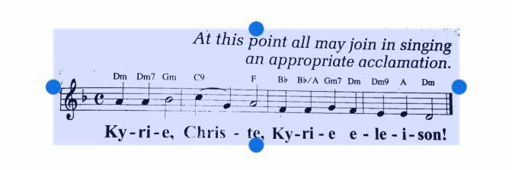

Slide 43
N It was two days before the Passover and the feast of Unleavened Bread, and the chief priests and scribes were looking for a way to arrest Jesus by some trick and have him put to death. For they said,
C It must not be during the festivities, or there will be a disturbance among the people.

Slide 44
N Jesus was at Bethany in the house of Simon the leper; he was at dinner when a woman came in with an alabaster jar of very costly ointment, pure nard. She broke the jar and poured the ointment on his head. Some who were there said to one another indignantly,
C Why this waste of ointment? Ointment like this could have been sold for over three hundred denarii and the money given to the poor.

Slide 46
N Judas Iscariot, one of the Twelve, approached the chief priests with an offer to hand Jesus over to them. They were delighted to hear it, and promised to give him money; and he looked for a way of betraying him when the opportunity should occur.
On the first day of Unleavened Bread, when the Passover lamb was sacrificed, his disciples said to him,
C Where do you want us to go and make the preparations for you to eat the Passover?

Slide 48
N …The chief priests and the whole Sanhedrin were looking for evidence against Jesus on which they might pass the death sentence. But they could not find any. Several, indeed, brought false evidence against him, but their evidence was conflicting. Some stood up and submitted this false evidence against him,
C We heard him say, “I am going to destroy this Temple made by human hands and in three days build another, not made by human hands.”

Slide 50
N And they all gave their verdict: he deserved to die. Some of them started spitting at him and, blindfolding him, began hitting him with their fists and shouting,
C Play the prophet!

Slide 52
N But he again denied it. A little later the bystanders themselves said to Peter,
C You are one of them for sure! Why, you are a Galilean.

Slide 54
N They shouted back.
C Crucify him!
N Pilate asked them,
O Why? What harm has he done?
N But they shouted all the louder,
C Crucify him!

Slide 55
N So Pilate, anxious to placate the crowd, released Barabbas for them and having ordered Jesus to be scourged, handed him over to be crucified.
The soldiers led him away to the inner part of the palace, that is, the Praetorium, and called the whole cohort together. They dressed him up in purple, twisted some thorns into a crown and put it on him. And they began saluting him,
C Hail King of the Jews!

Slide 56
N They struck his head with a reed and spat on him; and they went down …
… It was the third hour when they crucified him. The inscription giving the charge against him read: ‘The king of the Jews.’ And they crucified two robbers with him, one on his right and one on his left. The passers-by jeered at him; they shook their heads and said,
C Aha! So you would destroy the Temple and rebuild it in three days! Then save yourself: come down from the cross!

Slide 57
N The chief priests and the scribes mocked him among themselves in the same way. They said,
C He saved others, he cannot save himself. Let the Christ, the king of Israel, come down from the cross now, for us to see it and believe it.

Slide 58
N Even those who were crucified with him taunted him.
When the sixth hour came there was darkness over the whole land until the ninth hour. And at the ninth hour Jesus cried out in a loud voice,
J Eloi, Eloi, lama sabachthani?
N This means, ‘My God, my God, why have you deserted me?’ When some of those who stood by heard this, they said,
C Listen he is calling on Elijah.

Slide 59
N Someone ran and soaked a sponge in vinegar and, putting it on a reed, gave it him to drink, saying,
O Wait and see if Elijah will come to take him down.
N But Jesus gave a loud cry and breathed his last.
All kneel and pause a moment.

Slide 61
Apostles Creed
I believe in God,
the Father almighty,
Creator of heaven and earth,
and in Jesus Christ, his only Son, our Lord,
(At the words that follow, up to and including the Virgin Mary, all bow.)

Slide 62
who was conceived by the Holy Spirit,
born of the Virgin Mary,
suffered under Pontius Pilate,
was crucified, died and was buried;
he descended into hell;

Slide 63
on the third day he rose again from the dead;
he ascended into heaven,
and is seated at the right hand of God the Father almighty;

Slide 64
from there he will come to judge the living and the dead.
I believe in the Holy Spirit,
the holy catholic Church,

Slide 65
the communion of saints,
the forgiveness of sins,
the resurrection of the body,
and life everlasting.
Amen.

Slide 67
This slide is hidden.
Insert the Offertory Hymn after this slide.

Slide 68

First Collection
What you give here, goes to the Bishop for the support of the Diocese and it’s works.
Thank you for your generosity
Notes:
8th Sunday in Ordinary Time - Year A

Slide 69
Blessed be God
Blest are you Lord, God of all creation
Thanks to your goodness
This bread we offer
Fruit of the earth, work of our hands
It will become the bread of life
Licence No. CCLI 312895

Slide 70
Blessed be God, blessed be God
Blessed be God forever, amen
Blessed be God, blessed be God
Blessed be God forever, amen
Licence No. CCLI 312895

Slide 71
Blest are you Lord God or all creation
Thanks to your goodness
This wine we offer
Fruit of the vine, work of our hands
It will become the cup of joy
Licence No. CCLI 312895

Slide 72
Blessed be God, blessed be God
Blessed be God forever, amen
Blessed be God, blessed be God
Blessed be God forever, amen
Licence No. CCLI 312895

Slide 74
Priest: Pray my brothers and sisters,
that my sacrifice and yours may be
acceptable to God, the almighty Father.
All: May the Lord accept the sacrifice
at your hands for the praise and glory of his name, for our good and the good of all his holy Church.

Slide 75
Priest: The Lord be with you.
All: And with your spirit.
Priest: Lift up your hearts.
All: We lift them up to the Lord.

Slide 76
Priest: Let us give thanks to the
Lord our God.
All: It is right and just.

Slide 78
Holy
Holy, Holy, Holy Lord God of hosts,
Heaven and earth are full of your glory. Hosanna in the highest
Blessed is he who comes
in the name of Lord,
Hosanna in the highest.
Licence No. CCLI 312895

Slide 80
Memorial acclamation
Save us saviour of the world,
For by your cross and resurrection,
You have set us free

Slide 81
Memorial acclamation
When we eat this bread
And drink this cup
We proclaim your death O Lord
Until you come again

Slide 82
Memorial acclamation
We proclaim your death O Lord
And profess your resurrection
Until you come again
Licence No. CCLI 312895

Slide 84
Amen
Amen, amen, amen, amen.
Amen, amen, amen, amen.
Licence No. CCLI 312895

Slide 86
Priest: The Lord be with you.
All: And with your spirit

Slide 88
Peace
May the peace of the Lord be with you
With your friends and your family too
Let it be, let it grow
And everywhere you go
May the peace of the Lord follow you

Slide 89
Lamb of God
Lamb of God, lamb of God
You take away the sins of the world
Have mercy on us, lamb of God
Licence No. CCLI 312895

Slide 90
Lamb of God, lamb of God
You take away the sins of the world
Have mercy on us, lamb of God
Licence No. CCLI 312895

Slide 91
Lamb of God, lamb of God
You take away the sins of the world
Grant us, grant us peace
Licence No. CCLI 312895

Slide 93
Priest: Behold the Lamb of God, behold him who takes away the sins of the world.
Blessed are those called to the supper of the Lamb.
All: Lord, I am not worthy that you should enter under my roof, but only say the word and my soul shall be healed.

Slide 94
This slide is hidden.
Insert the Communion Hymns after this slide.

Slide 95
In love for me
This is my body broken for you
Bringing you wholeness making you free
Take it and eat it, and when you do
Do it in love for me
Licence No. CCLI 312895

Slide 96
This is my blood poured out for you
Bringing forgiveness, making you free
Take it and drink it, and when you do
Do it in love for me
Licence No. CCLI 312895

Slide 97
This is my body broken for you
Bringing you wholeness making you free
Take it and eat it, and when you do
Do it in love for me
Licence No. CCLI 312895

Slide 98
This is my blood poured out for you
Bringing forgiveness, making you free
Take it and drink it, and when you do
Do it in love for me
Do it in love for me
Licence No. CCLI 312895

Slide 99
Eat this bread
Eat this bread, drink this cup
Come to me and never be hungry
Eat this bread, drink this cup
Trust in me and you will not thirst
Licence No. CCLI 312895

Slide 100
I am the bread of life
The true bread sent from the Father
Licence No. CCLI 312895

Slide 101
Eat this bread, drink this cup
Come to me and never be hungry
Eat this bread, drink this cup
Trust in me and you will not thirst
Licence No. CCLI 312895

Slide 102
Your ancestors ate manna in the desert
But this is the bread come down from heaven
Licence No. CCLI 312895

Slide 103
Eat this bread, drink this cup
Come to me and never be hungry
Eat this bread, drink this cup
Trust in me and you will not thirst
Licence No. CCLI 312895

Slide 104
Eat my flesh and drink my blood
And I will raise you up on the last day
Licence No. CCLI 312895

Slide 105
Eat this bread, drink this cup
Come to me and never be hungry
Eat this bread, drink this cup
Trust in me and you will not thirst
Licence No. CCLI 312895

Slide 106
Any one who eats this bread
Will live forever
Licence No. CCLI 312895

Slide 107
Eat this bread, drink this cup
Come to me and never be hungry
Eat this bread, drink this cup
Trust in me and you will not thirst
Licence No. CCLI 312895

Slide 108
If you believe and eat this bread
You will have eternal life
Licence No. CCLI 312895

Slide 109
Eat this bread, drink this cup
Come to me and never be hungry
Eat this bread, drink this cup
Trust in me and you will not thirst
Licence No. CCLI 312895

Slide 110
Above all
(Lenny LeBlanc, Paul Baloche)
Above all powers, above all kings
Above all nature and all created things
Above all wisdom and all the ways of man
You were here before the world began

Slide 111
Above all kingdoms, above all thrones
Above all wonders the world has ever known
Above all wealth and treasures of the earth
There's no way to measure what You're worth

Slide 112
Crucified, laid behind a stone
You lived to die rejected and alone
Like a rose trampled on the ground
You took the fall and thought of me
Above all

Slide 113
Crucified, laid behind a stone
You lived to die rejected and alone
Like a rose trampled on the ground
You took the fall and thought of me
Above all
“Above all” Words & music by Lenny LeBlanc, Paul Baloche
© 1999 Integrity's Hosanna Music
Used by Permission. CCLI License #89350

Slide 115
This slide is hidden.
The next slide can be used for videos.
Insert the video into the slide.

Slide 116
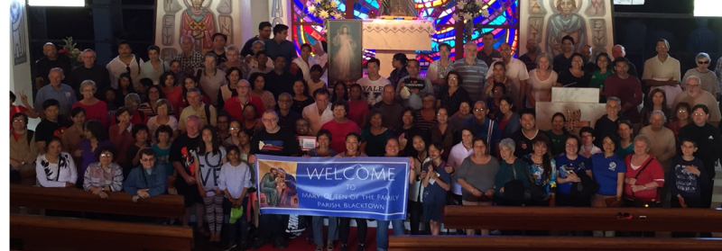
Second Collection
What you give here, is for the
support of our parish: Both our
Churches and our Parish Mission.
Thank you for your generosity

Slide 117
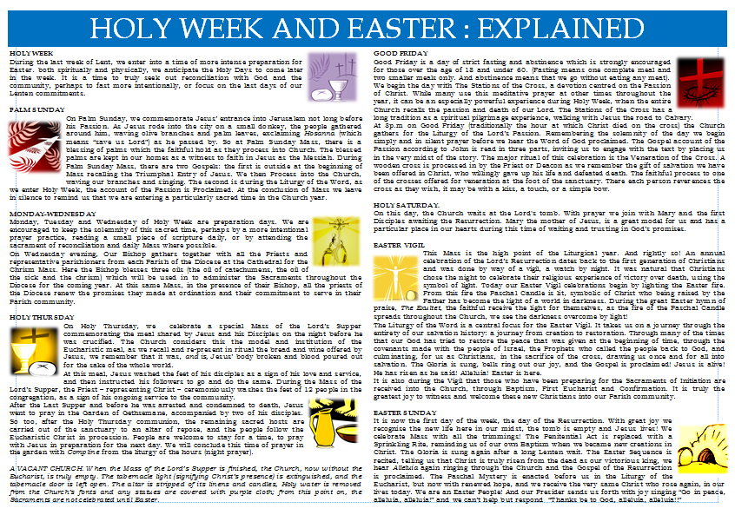
HOLY WEEK EXPLAINED

Slide 118

HOLY LAND COLLECTION

Slide 119


STAY CONNECTED
www.facebook.com/blacktowncatholics/

Slide 120
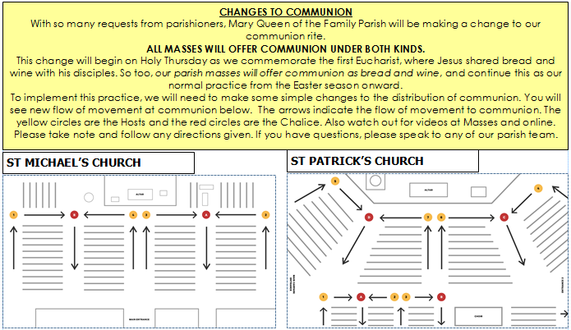
NEW COMMUNION FLOW

Slide 121
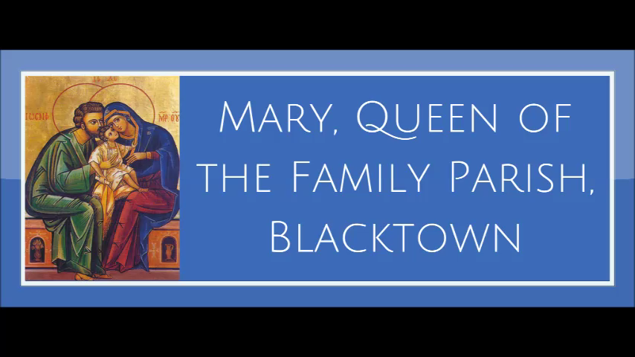
COMMUNION FLOW VIDEO
ST MICHAEL’S

Slide 123
Prayer for the sick and housebound
Dear Jesus,
You walked on the earth, understood the broken world, yet also rose from death into resurrected life. We pray for our loved ones that they will be held at this time in your loving arms. Come fill them with your restorative Spirit. May your resurrection bring healing and wellness into their being. May your grace carry them through this hard time into a new season filled with hope and joy. Amen.
Mary, Queen of the Family – pray for us.

Slide 125

WE ALL LEAVE IN SILENCE…
PLEASE RESPECT THIS TIME OF QUIET AS WE ENTER HOLY WEEK
Notes:
8th Sunday in Ordinary Time - Year A

Slide 126
This slide is hidden.
Insert the Recessional Hymns after this slide.

Slide 127
This slide is hidden.
Insert the final slide here.

